Slide 1
Mid-Term Defense on
DEPARTMENTAL STORE MANAGEMENT SYSTEM
Team members :-
Niru Kumari Mishra (740325)
Rabin Phaiju (740329)
Rodip Duwal (740334)
Roshan Dumaru (740335)

Slide 2
Contents
Introduction
Literature Review
Scope & Limitation
Objectives
Methodology
Result
Reference

Slide 3
Introduction
A program that manages store detail & transaction
Developed to meet user needs
Provides information lists related to store
Fast and reliable

Slide 4
Literature Review
As in our reference project (mini-project-in-c-DSMS)
interface were not attractive
customer, vendor and financial report were not included

Slide 5
Objectives
To manage store transaction and details effectively

Slide 6
Scope & Limitation
Scope:
Implement in various store
Easy and user friendly
Limitation:
Online operation
Limited category

Slide 7
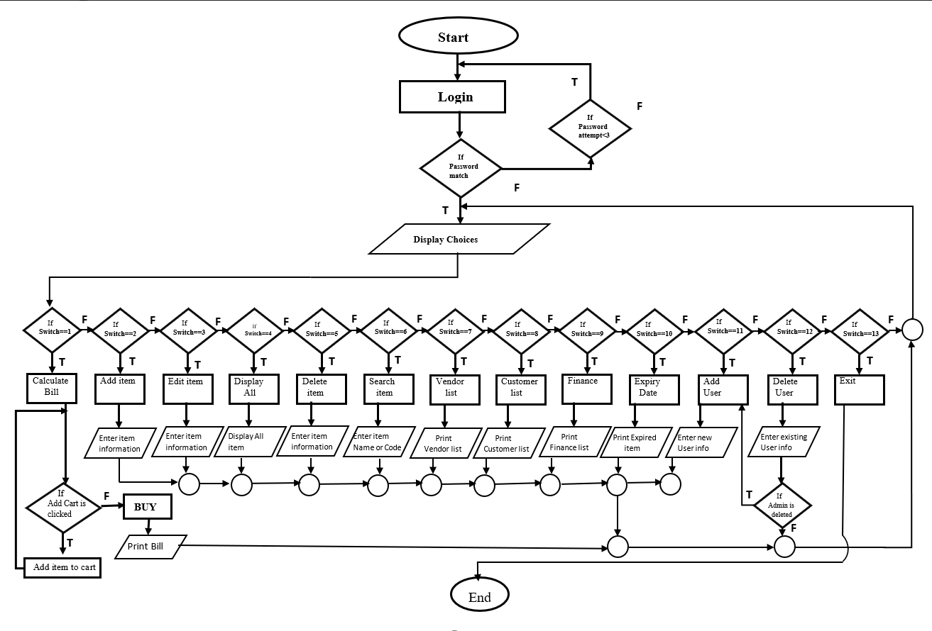
Methodology
Flowchart

Slide 8
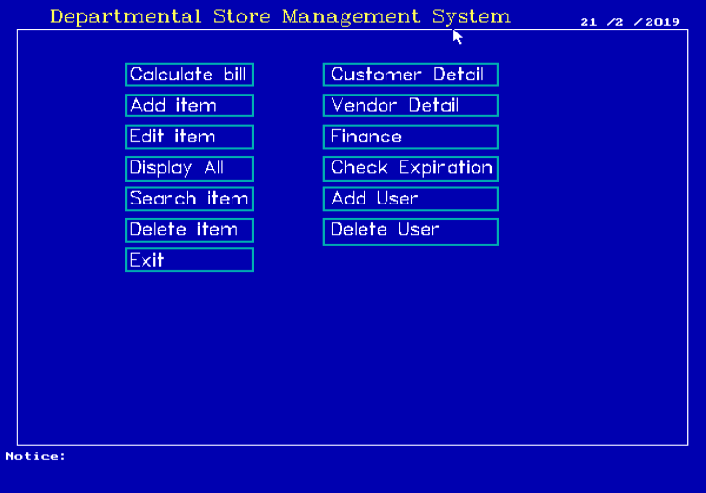
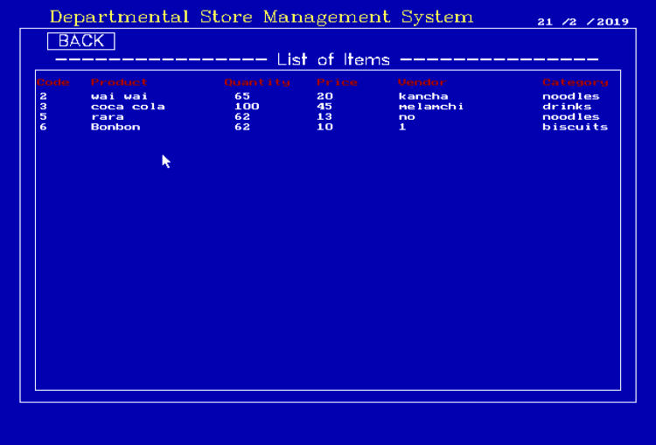
Result
Task Completed :
Homepage
Display

Slide 9
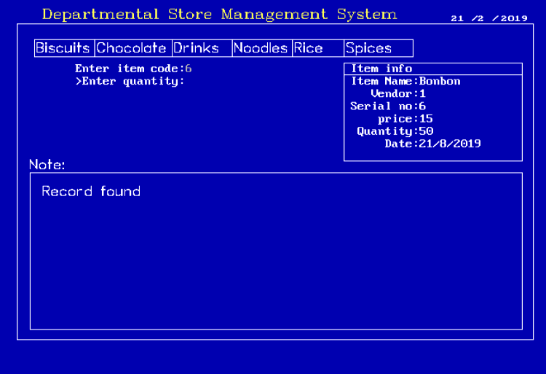
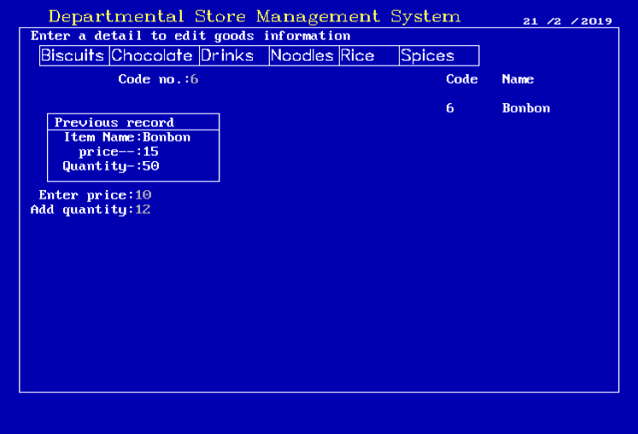
Task Completed :
Add Item
Edit Item

Slide 10
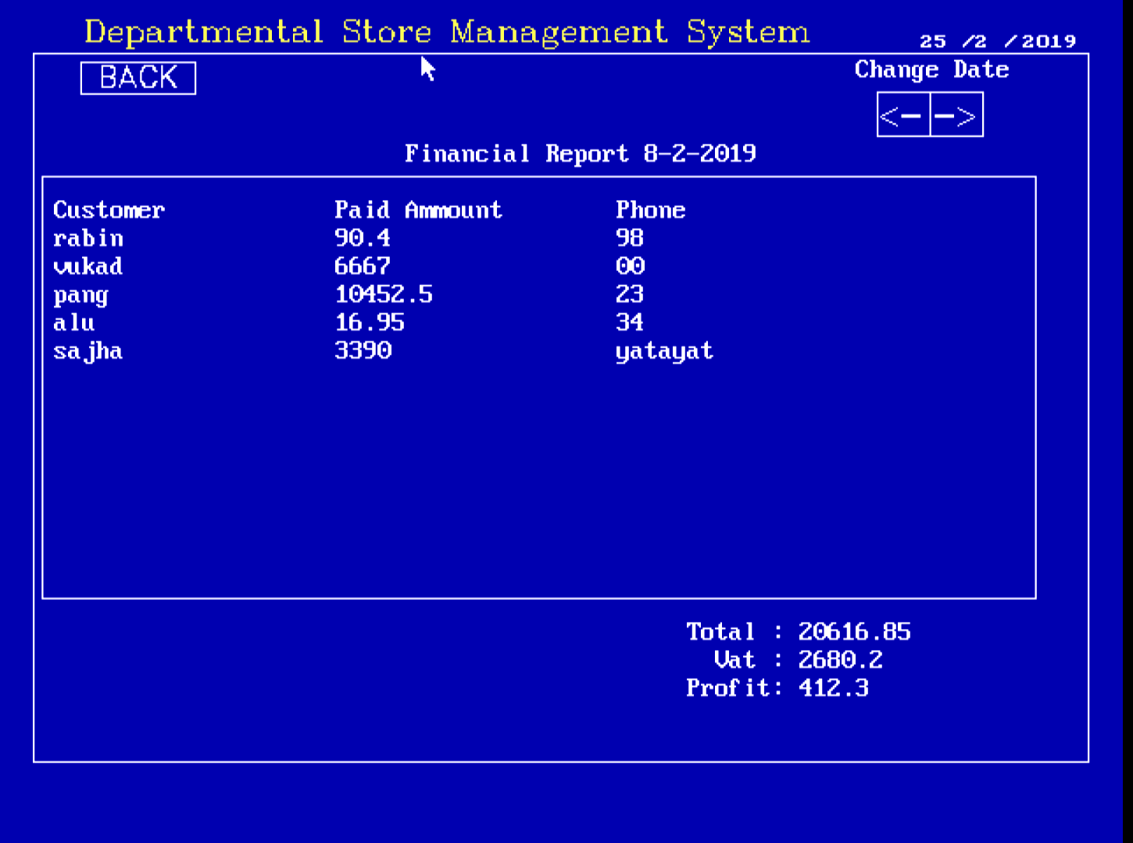
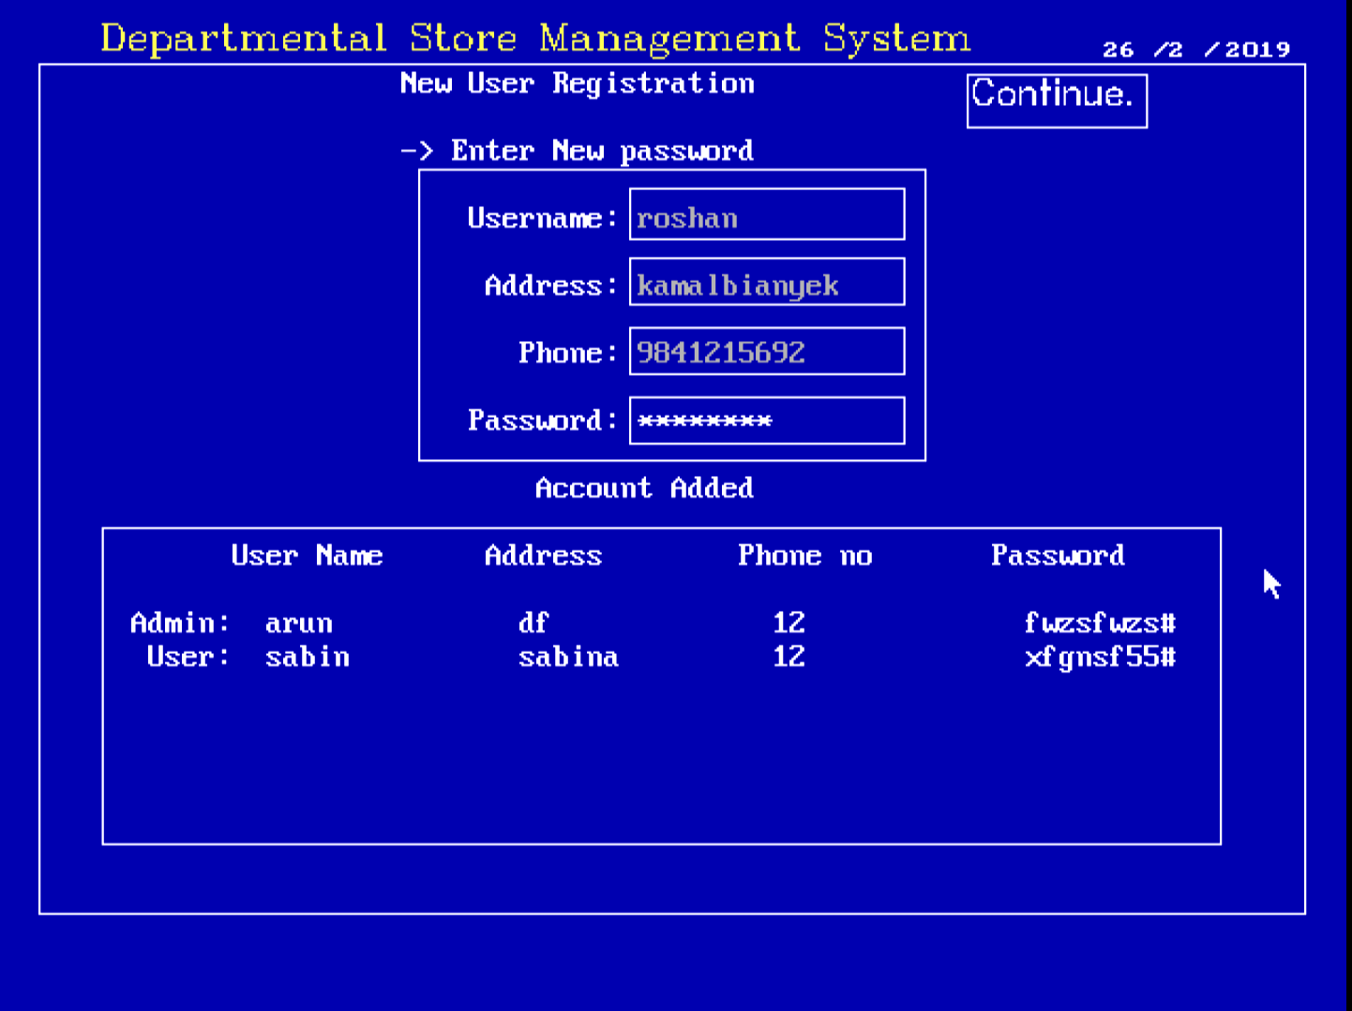
Task Completed :
Finance
Add User

Slide 11
Remaining Task :
Expiration Date
Notice
Improving interface

Slide 12
Reference :
https://www.codewithc.com/category/cpp-tutorial/ [11/18/2018]
https://www.programiz.com/c-programming/examples [12/18/2018]

Slide 13
Thank You

Slide 14
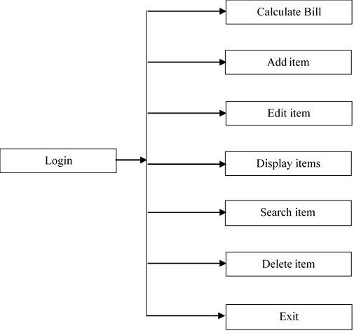
Generic Model

Slide 15
Statement of Problem
Editing of pre-existing records
Insufficiency in search engine(by name & serial code )
Absence of password system

